Slide 1



Saving Data in MongoDB
Mark J. Buckler
OCPJP,CIWJS

Slide 2

Credits
Some of the contents of this slide presentation have been referenced and reproduced, from RESTful Web API Design with Node.js, by Saleh Hamadeh, ©2017 LinkedIn Corporation.
Additional content has been referenced and reproduced, from Understanding REST, by Michael Sullivan, ©2017 LinkedIn Corporation.

Slide 3
LEARNING OBJECTIVES
Relational Databases vs. Document-Oriented Databases
Enable MongoDB Support in an Application
Connect to a MongoDB Database
Insert Data into a MongoDB Database
Retrieve Data from a MongoDB Database
Delete Data from a MongoDB Database

Slide 4
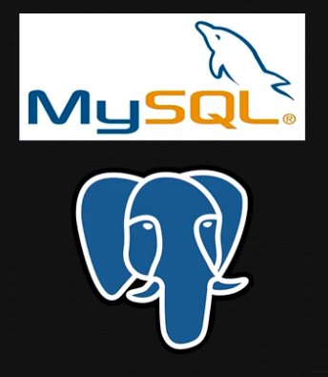
Relational vs. Document Databases
Relational Databases
Store data in tables
Consist of rows, columns, and relationships
Enforce strict schemas at the database level
Developers have less freedom, more consistency
Queried using SQL
Proven to work for sites of all sizes
Have been used for a very long time

Slide 5

Relational vs. Document Databases
Document Databases
Store data in collections of documents
Each document is a map of keys to values
Flexible schemas for collecting aggregate data
Queried using JSON
Fast-growing and relatively new – widely supported
Integrates well with JavaScript

Slide 6
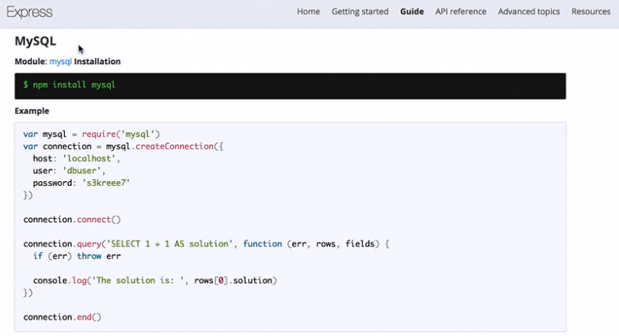
Relational vs. Document Databases
Node.js MySQL Integration

Slide 7
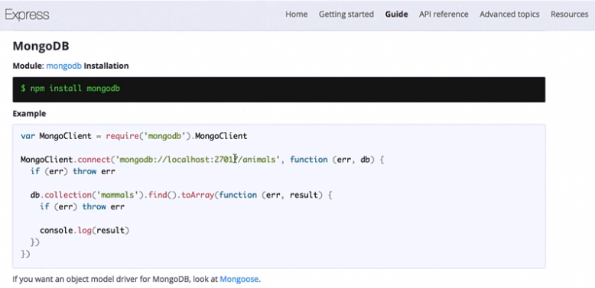
Relational vs. Document Databases
Node.js MongoDB Integration

Slide 8

Working With MongoDB
Programming Exercise02_04_01 – Step 1
Enable MongoDB Support in the Application

Slide 9
Working With MongoDB
Programming Exercise02_04_01 – Step 2
Connect to a MongoDB Database

Slide 10
Working With MongoDB
Programming Exercise02_04_01 – Step 3
Insert Data into a MongoDB Database

Slide 11
Working With MongoDB
MongoDB – Cursored Collections
A query to MongoDB, using a find()method, produces a result set , like a relational database
What is returned is a pointer to the results called a cursor
A cursor is an object which has many methods that can be used on the result set
The MongoDB API documentation provides references to these methods
One very useful method is cursor.toArray()
This returns an array of all of the documents returned by the cursor

Slide 12
Working With MongoDB
Programming Exercise02_04_01 – Step 4
Retrieve Data from a MongoDB Database

Slide 13
Working With MongoDB
Programming Exercise02_04_01 – Step 5
Deleting Data from a MongoDB Database

